Slide 1
INTRODUCTION TO DATA SCIENCE
Project
Failure Prediction
TEAM 14

Slide 2



Team members
Pham
Haven
Hussain
2299356
2308018
2338250
`

Slide 3


Team members
Preetham
Jayanth
Srikavya
2288949
2288552
2311351
`

Slide 4
Abstract
The MetroPT-3 dataset exhibits pressure, temperature, motor current, and air intake valse of a compressor's Air Production Unit (APU) in an operational metro.
Our project embarks on the task of leveraging the MetroPT-3 dataset to develop robust predictive models tailored for failure predictions. By employing a multifaceted approach, we construct a spectrum of models, ranging from conventional techniques like Linear Regression, Naive Bayes, KNN, SVM, and Random Forest to advanced methods including XGBoost, Extreme Learning Machine (ELM), and Neural Networks.
Our methodology involves hyperparameter tuning, ensuring that each model is finely calibrated to the unique characteristics of the MetroPT-3 dataset. This optimization enhances the models' predictive capabilities, paving the way for more accurate and timely identification of potential maintenance issues.

Slide 5
Failure Prediction
The prediction of Air Production Unit (APU) failures in metro train operations stands as a critical challenge for maintenance efficiency and operational reliability. Traditionally, preventive and reactive maintenance strategies have been employe. These method often relying on predefined schedules or post-failure responses. However, the dynamic nature of APU failures necessitates a more proactive approach.
Popular methodologies in the past have included rule-based systems and statistical analysis, yet these approaches often fall short in capturing the nuanced patterns indicative of impending failures.
Machine learning emerges as a transformative solution to this problem, offering the capability to analyze intricate relationships within the MetroPT-3 dataset and discern early warning signs of APU failures. By leveraging knowledge from the data, machine learning enables the development of predictive models that can identify potential issues before they escalate, thereby optimizing maintenance efforts and bolstering the overall reliability of metro train operations.

Slide 6
MetroPT-3 Dataset
From a metro train in an operational context, readings from pressure, temperature, motor current, and air intake valves were collected from a compressor's Air Production Unit (APU). This dataset reveals real predictive maintenance challenges encountered in the industry. It can be used for failure predictions, anomaly explanations, and other tasks.
# Instances: 1516948
# Features: 15
Dataset Characteristics: Tabular, Multivariate, Time-Series

Slide 7
Approaches
Build and examine machine learning models with different level of complexity
Traditional models such as Linear Regression, Naïve Bayes, KNN, Random Forest and Support Vector Machine
Advanced models such as XGBoost, Extreme Machine Learning, Neural Network and Ensemble Method
Apply hyperparameter searching to find the best model
Employ metrics such as accuracy, precision, recall, F1-score to evaluate and compare models

Slide 8
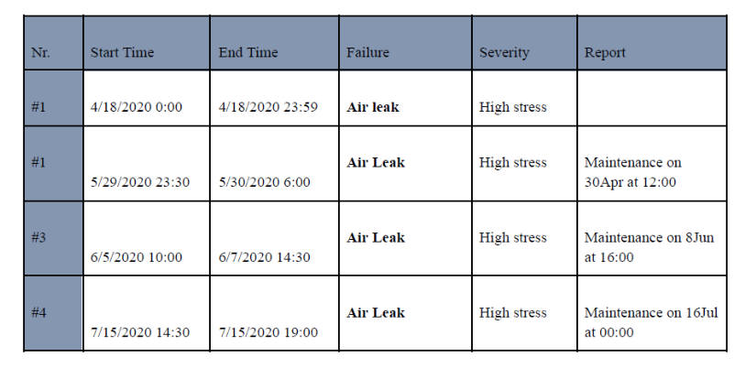
Data Preprocessing
Clean and label
Remove unnecessary column
Format the timestamp column
Label data (Original dataset is not labelled)
Subsample to balance the dataset (Original dataset is highly imbalanced)
Find and drop all outliers

Slide 9
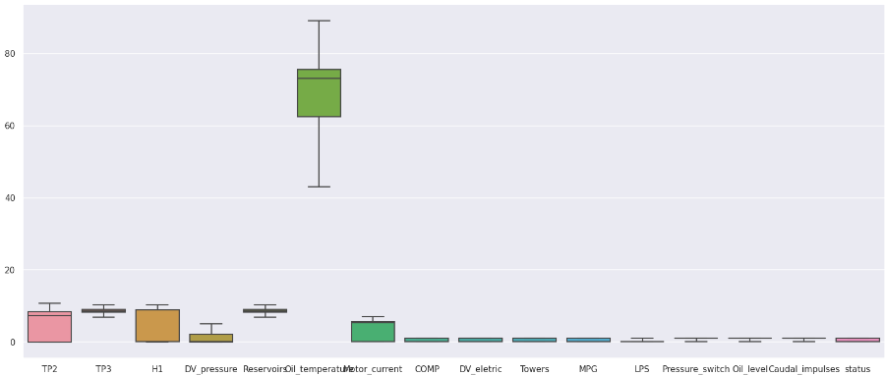
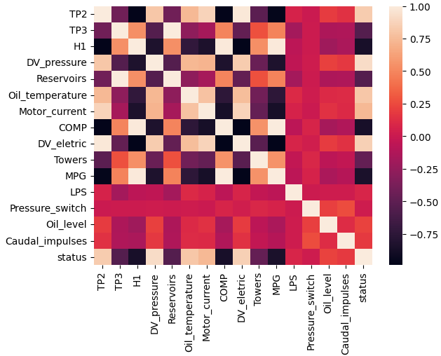
Exploratory Data Analysis
We observed that:
There are strong linear relationship among features
No outliers left after preprocessing
Data needs scaling before training

Slide 10
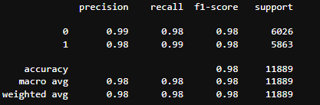
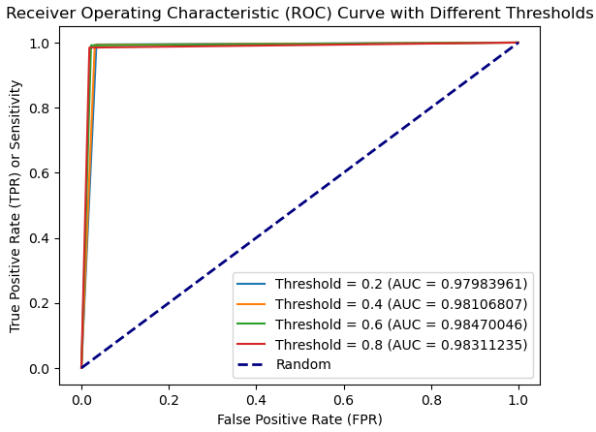
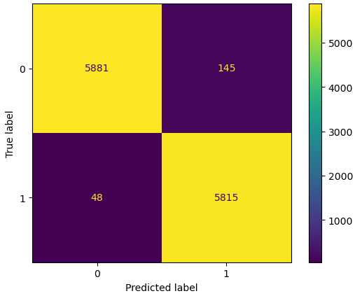
Linear Regression

Slide 11
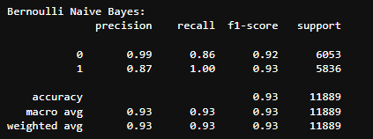
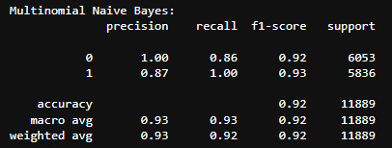
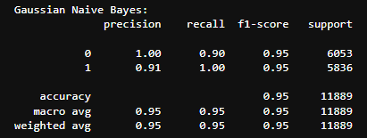
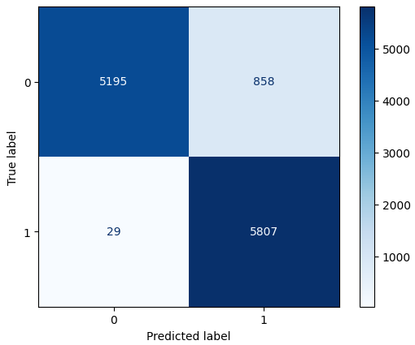


Naïve Bayes

Slide 12
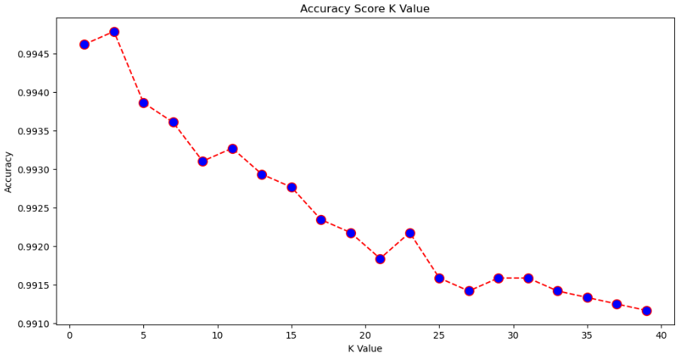

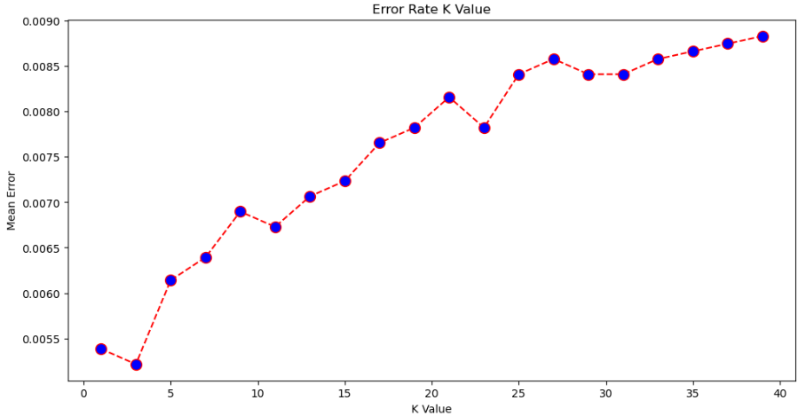
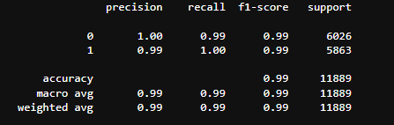
K-Nearest Neigbors
K=3 yields best results

Slide 13
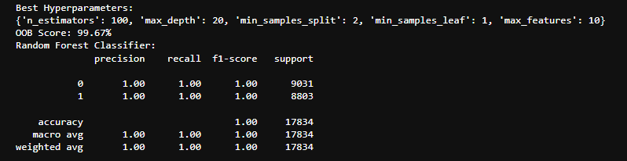
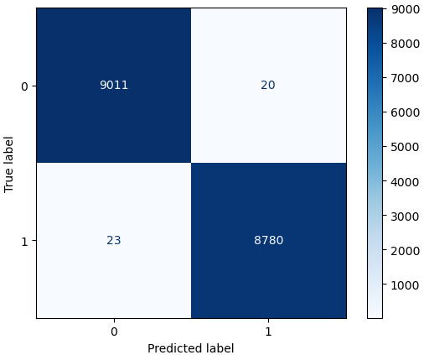
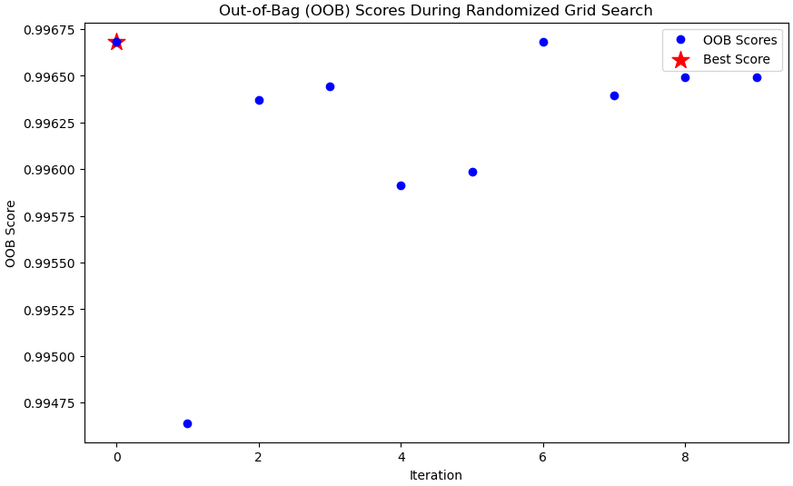
Random Forest

Slide 14
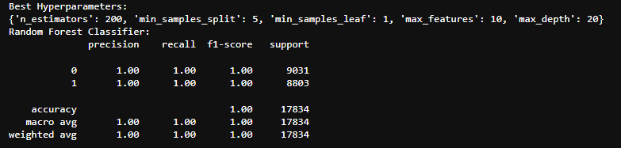

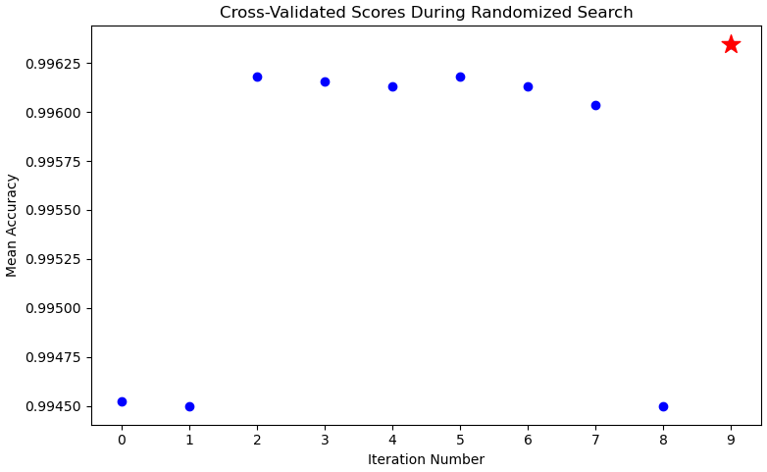
Random Forest

Slide 15
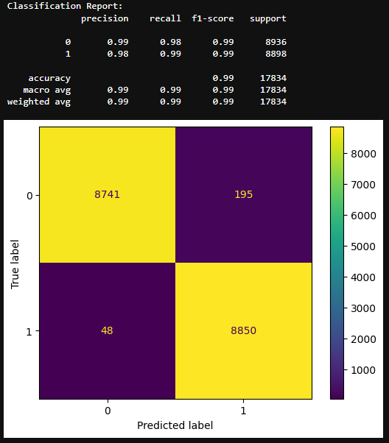
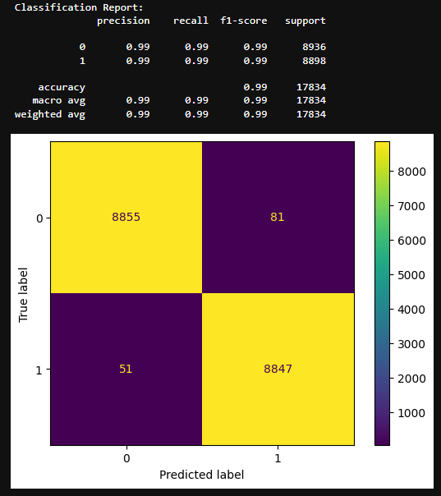
Support Vector Machine
Linear Kernel
Gaussian Kernel

Slide 16
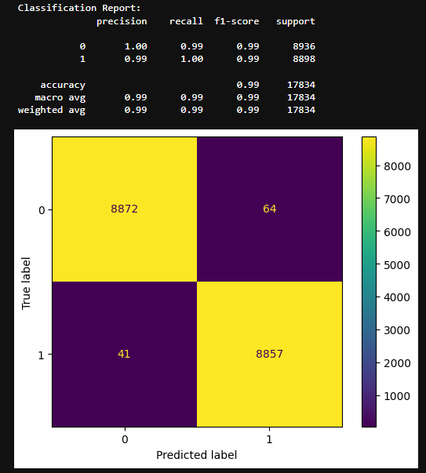
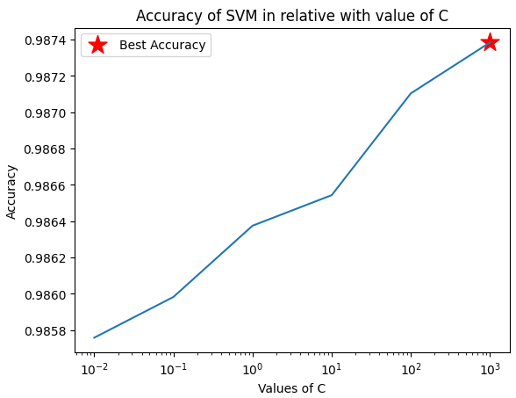
Support Vector Machine
C=1000 yields best prediction

Slide 17
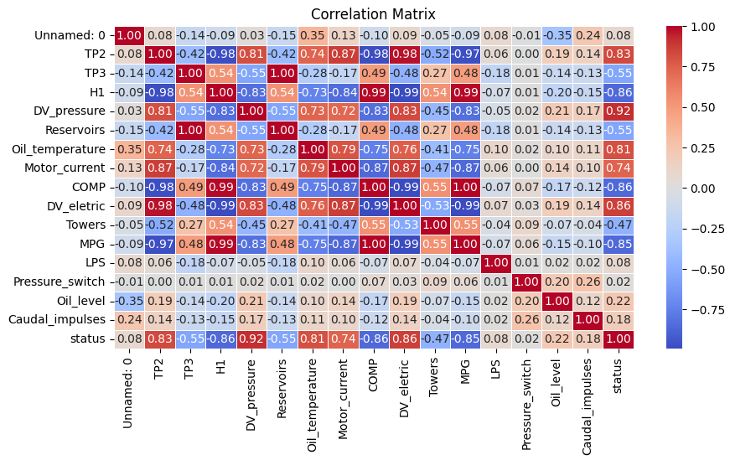
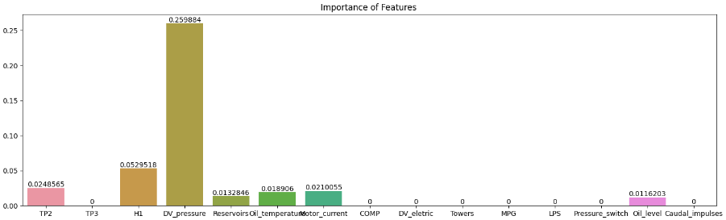
Features Selection
Lasso Cross Validation

Slide 18
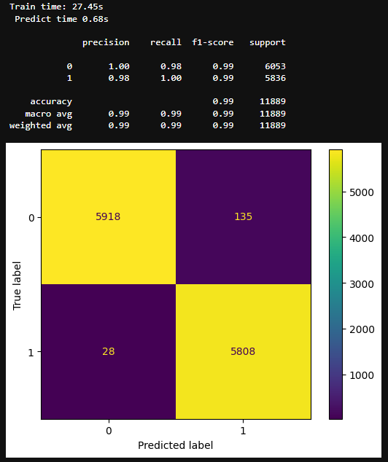
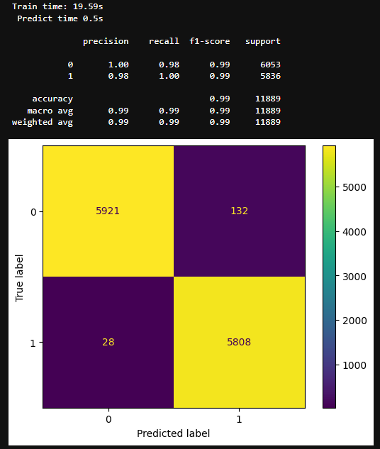
Features Selection
Lasso Cross Validation
Before feature selection
After feature selection

Slide 19
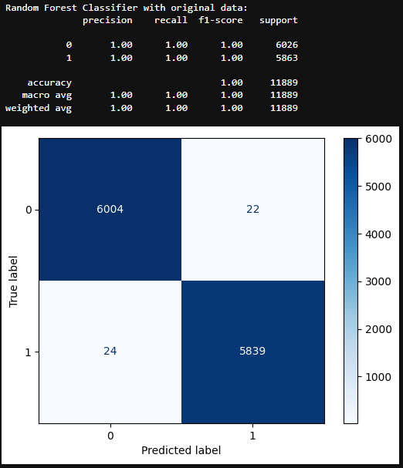
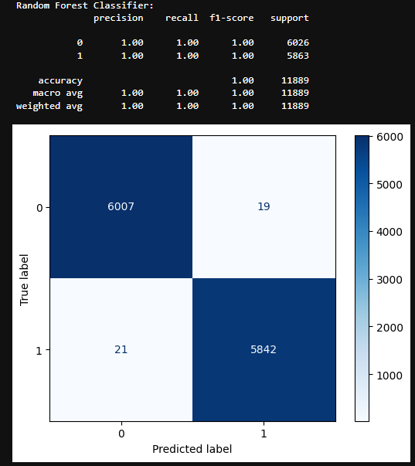
Bidirectional Elimination
Before feature selection
After feature selection

Slide 20
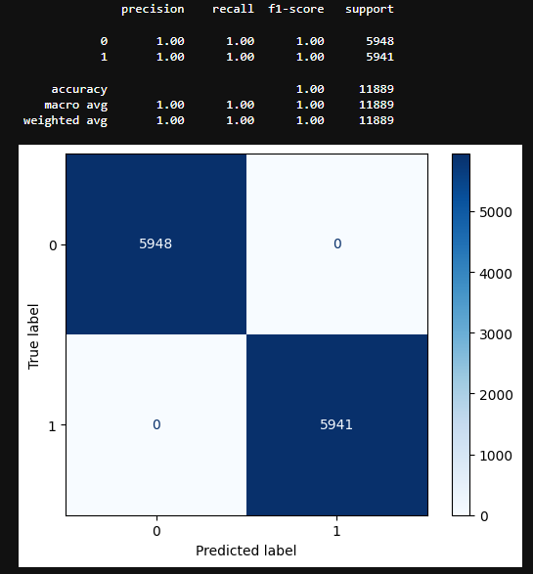
XGBoost

Slide 21
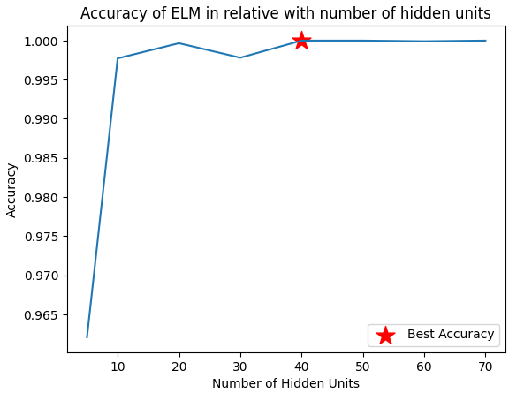
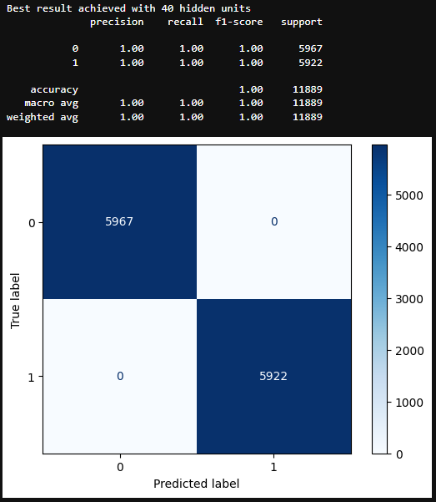
Extreme Machine Learning

Slide 22
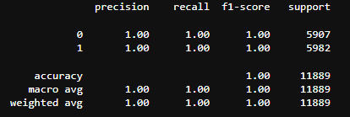


Neural Network

Slide 23

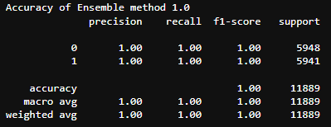
Ensemble Method
Average prediction of 3 top models:
XGBoost
Extreme Learning Machine
Neural Net

Slide 24
Result and discussion
Algorithms | Precision | Recall | F1-score
Linear Regression | 0.98 | 0.98 | 0.98
Naïve-Bayes | 0.95 | 0.95 | 0.95
K-nearest Neighbors | 0.99 | 0.99 | 0.99
Random Forest | 1.00 | 1.00 | 1.00
Support Vector Machine | 0.99 | 0.99 | 0.99
Extreme Machine Learning | 1.00 | 1.00 | 1.00
XGBoost | 1.00 | 1.00 | 1.00
Neural net | 1.00 | 1.00 | 1.00
Ensemble | 1.00 | 1.00 | 1.00

Slide 25
Result and discussion
The dataset is highly linear separatable.
Overall performance is high.
Scaling and feature selection significantly improve accuracy
Correlations between variables are strong, thus Naïve Bayes did not perform well because it assumed independence of variables
Extreme Learning Machine always converge to global maxima unlike Neural Network

Slide 26
Thank you
Team 14

